Slide 1

Enhancing confidence estimation with local information through diffeomorphisms
By Thomas Hasler

Slide 2
Why do we need confidence estimation ?

Slide 3
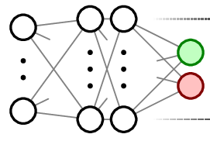
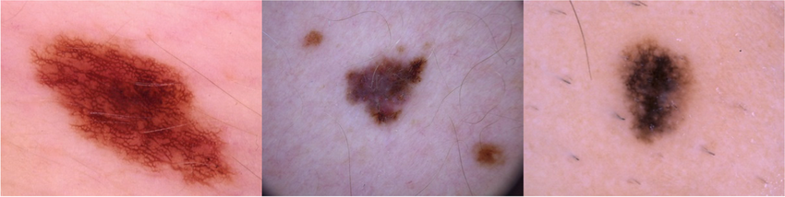



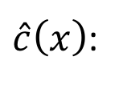
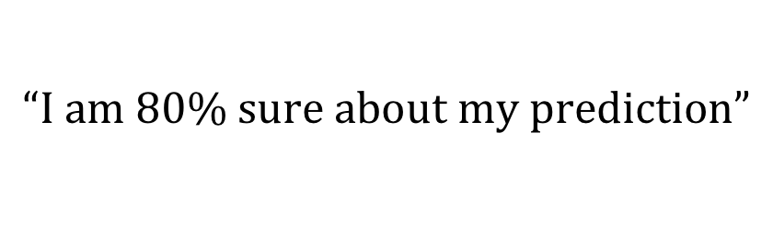
Example – melanoma detection
Suppose there is a new neural network used to classify moles (benign, melanoma):
We want not only the network’s prediction but how confident it is in this prediction:
To know when we should trust the prediction or to have a doctor’s opinion instead.
$$“Melanoma”$$
$$x$$
$$\hat{y}\left(x\right)$$
$\hat{c}\left(x\right)$:
$$“I am 80\% sure about my prediction”$$

Slide 4
To understand how confident the network is in its particular prediction.
Why do we need confidence estimation ?

Slide 5
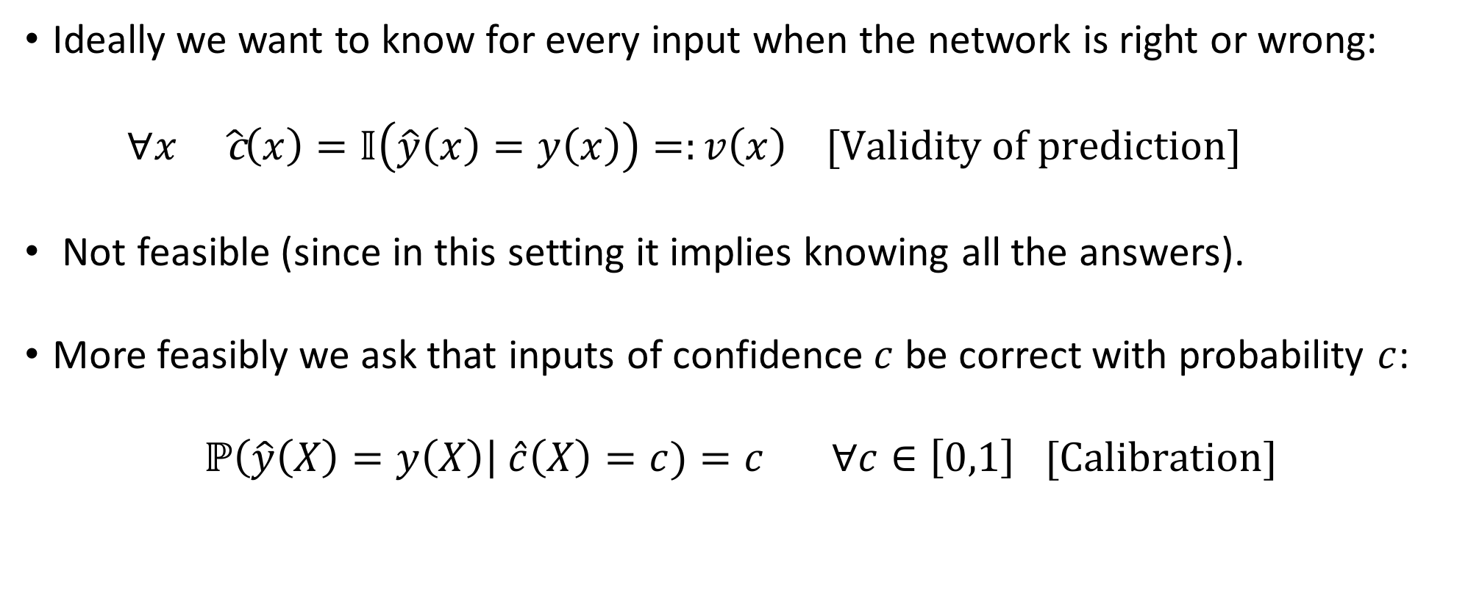
Confidence as a probability of being right
Ideally we want to know for every input when the network is right or wrong:
$$∀x \hat{\text{c}}\left(x\right)=𝕀\left(\hat{y}\left(x\right)=y\left(x\right)\right)=:v\left(x\right) [Validity of prediction]$$
Not feasible (since in this setting it implies knowing all the answers).
More feasibly we ask that inputs of confidence $c$ be correct with probability $c$:
$$ℙ\left(\hat{y}\left(X\right)=y\left(X\right)\right| \hat{c}\left(X\right)=c)=c ∀c∈\left[0,1\right] [Calibration]$$

Slide 6
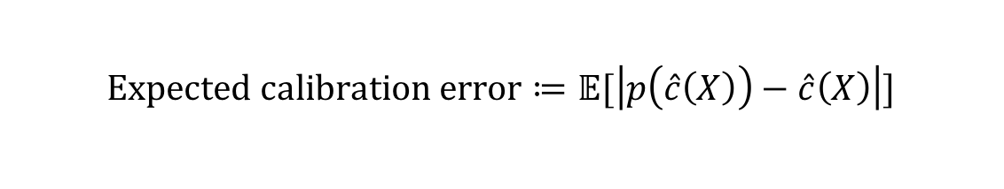









Deviation from calibration & expected calibration error
we can introduce a measure to verify how calibrated $\hat{c}\left(x\right)$ is:
$$p_{\hat{c}}\left(c\right):=ℙ\left(\hat{y}\left(X\right)=y\left(X\right)\right| \hat{c}\left(X\right)=c)$$
$$1$$
$$p_{\hat{c}}\left(c\right)$$
$$c$$
Deviation from calibration
$$p_{\hat{c}}\left(c\right)$$
Measure to try and minimize :
$$Expected calibration error≔𝔼[\left|p\left(\hat{c}\left(X\right)\right)−\hat{c}\left(X\right)\right|]$$
$$0$$
$$0$$
$$c$$
$$1$$

Slide 7
Is calibration all that is needed?

Slide 8








Accuracy is a calibrated confidence estimator
“If my network is right 80% of the time, then I can always say that it is 80% confident in its prediction”
The predictor’s accuracy, $a_{\hat{y}}$ can be taken as a confidence estimator:
It is perfectly calibrated!
$$∀x \hat{c}\left(x\right)=a_{\hat{y}}$$
$$1$$
$$p_{a_{\hat{y}}}\left(c\right)$$
$$a_{\hat{y}}$$
$$c$$
$$p_{a_{\hat{y}}}\left(c\right)$$
$$0$$
$$a_{\hat{y}}$$
$$0$$
$$c$$
$$1$$

Slide 9
Accuracy is a bad confidence estimator
It tells us nothing on the particular prediction:
Not discriminating between good and bad predictions (input independent)
From an information theory perspective, not informative on validity of prediction

Slide 10
No, because calibration simply ensures that the confidence estimate is interpretable as probability, not how well it discerns right from wrong
Is calibration all that is needed?

Slide 11







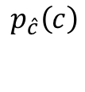

Calibrating confidence via transformation
Given an uncalibrated confidence estimator, one can generate a calibrated one by applying $p\left(c\right)$:
$$\hat{c}\left(x\right)⟶\hat{\tilde{c}}\left(x\right):=p_{\hat{c}}(\hat{c}\left(x\right))$$
In practice $p\left(c\right)$ can be approximated by a kernel method on a validation set :
$$p_{\hat{c}}\left(c\right)⟶{{\hat{p}}_{\hat{c}}}^{K}\left(c\right) \hat{\tilde{c}}\left(x\right)⟶{\hat{c}}^{K}\left(x\right):={{\hat{p}}_{\hat{c}}}^{K}(\hat{c}\left(x\right))$$
$$1$$
$$p_{\hat{c}}\left(c\right)$$
$$1$$
$$p_{\hat{\tilde{c}}}\left(\tilde{c}\right)$$
$$c$$
$$c$$
$$p_{\hat{c}}\left(c\right)$$
$$p_{\hat{\tilde{c}}}\left(\tilde{c}\right)$$
$$0$$
$$0$$
$$0$$
$$c$$
$$1$$
$$0$$
$$\tilde{c}$$
$$1$$

Slide 12
How do we know how well the (calibrated) confidence estimator is at discriminating right from wrong?

Slide 13
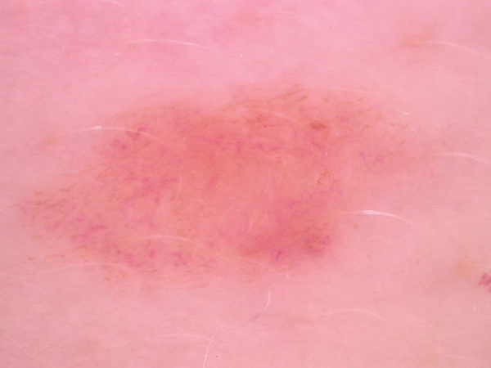
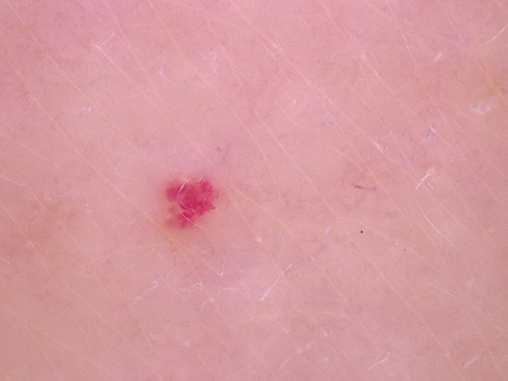
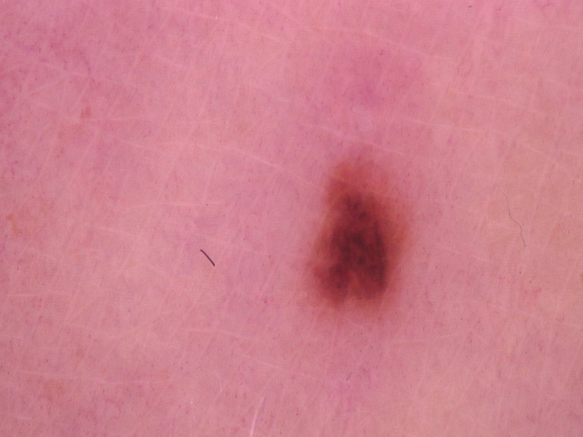
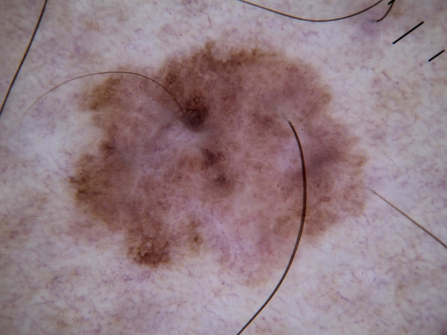
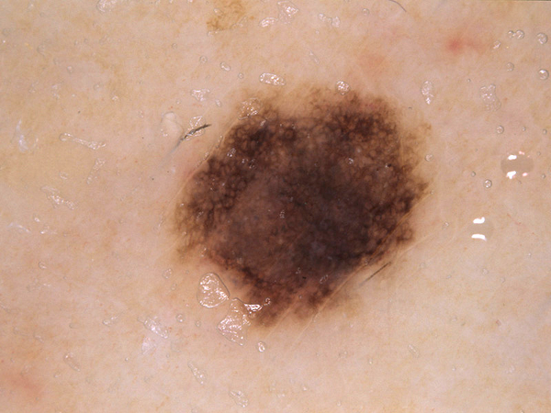
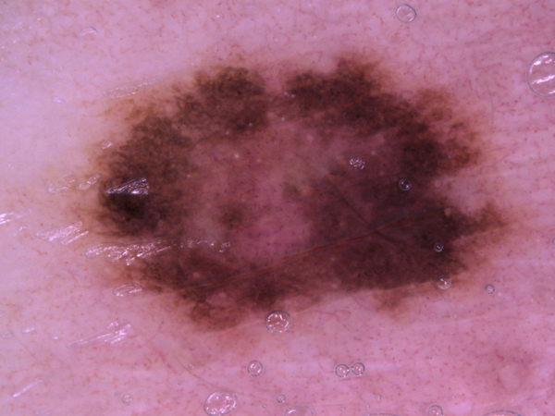




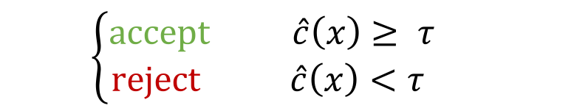

Discrimination – failure prediction
Suppose we wanted to identify wrong predictions and reject them.
e.g to get a doctor’s opinion instead.
Idea: Ignore likely wrong predictions by only considering predictions above a certain confidence threshold $τ:$
$$\left\{\begin{aligned}accept \hat{c}\left(x\right)≥ τ \\ reject \hat{c}\left(x\right)<τ \end{aligned}\right.$$
$$reject$$
$$accept$$
$$τ$$
$$\hat{c}\left(x\right)$$

Slide 14




Risk coverage curves & area under the curve
There is trade-off between how many predictions are considered (coverage) and how low the number of errors (risk) is.
e.g we want to minimize miss-diagnosis whilst minimizing human intervention (extra cost)
Measure independent $τ$- area under the risk-coverage curve (lower is better)
$$1$$
$$Risk(τ)$$
$$0$$
$$Coverage(τ)$$
$$1$$

Slide 15
We can look at the area under the risk-coverage curve which represents the expected errors one would make if we only consider confidences above a threshold
How do we know how well the (calibrated) confidence estimator is at discriminating right from wrong?

Slide 16
what could be an alternative measure if we wanted to consider all predictions (no thresholding)?

Slide 17
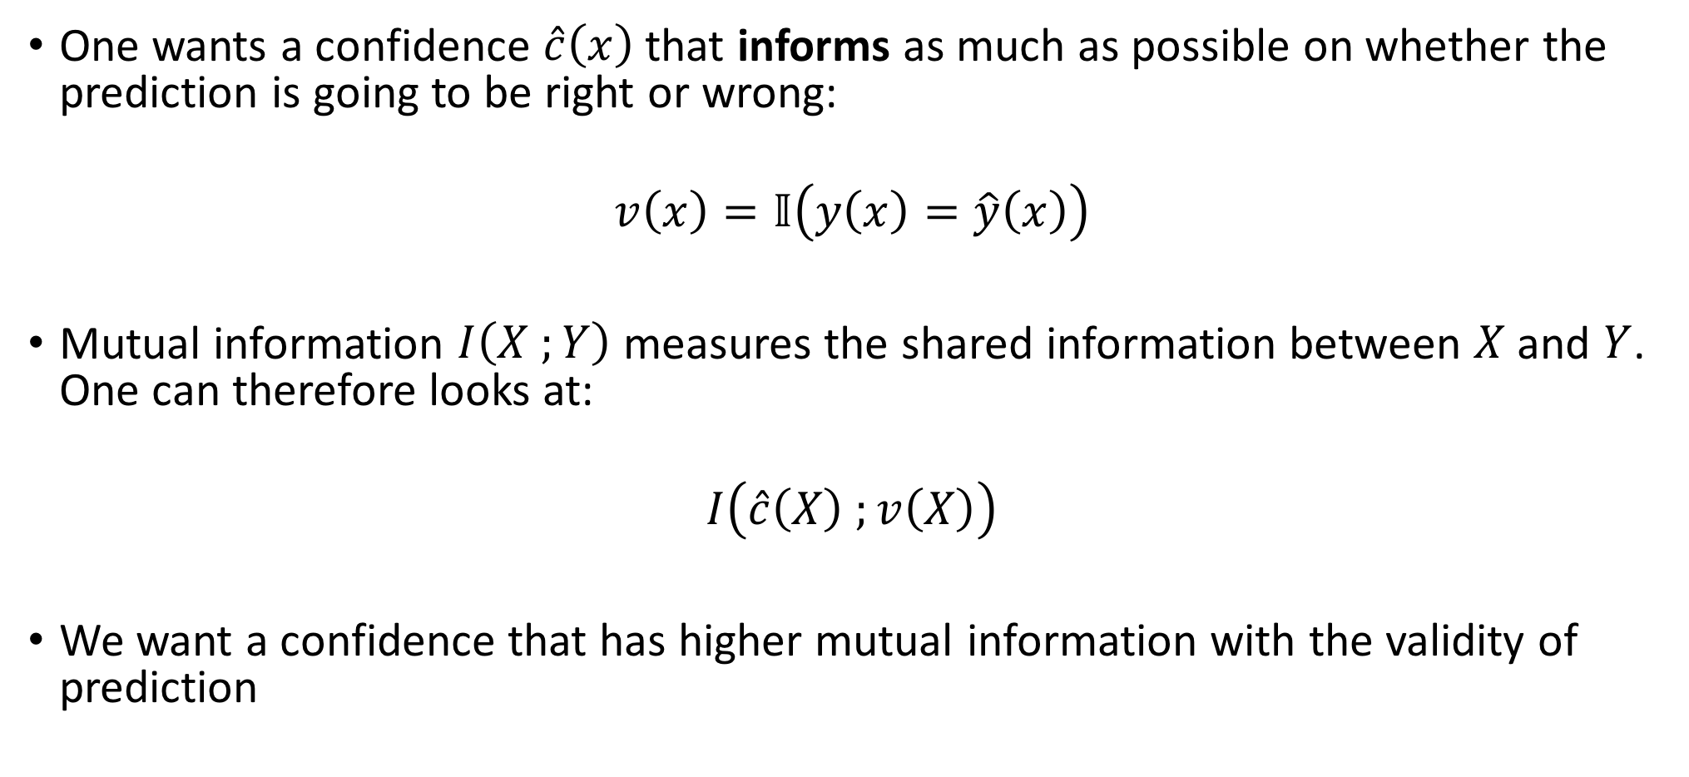
Confidence should inform on probability of correct prediction
One wants a confidence $\hat{c}\left(x\right)$ that informs as much as possible on whether the prediction is going to be right or wrong:
$$v\left(x\right)=𝕀\left(y\left(x\right)=\hat{y}\left(x\right)\right)$$
Mutual information $I\left(X ;Y\right)$ measures the shared information between $X$and $Y$. One can therefore looks at:
$$I\left(\hat{c}\left(X\right) ;v\left(X\right)\right)$$
We want a confidence that has higher mutual information with the validity of prediction

Slide 18

what could be an alternative measure if we wanted to consider all predictions (no thresholding)?
Looking at the mutual information between the confidence estimator $\hat{c}\left(X\right)$ and validity of prediction $v\left(X\right)$

Slide 19




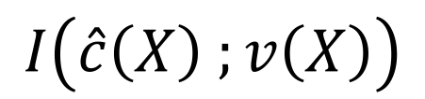




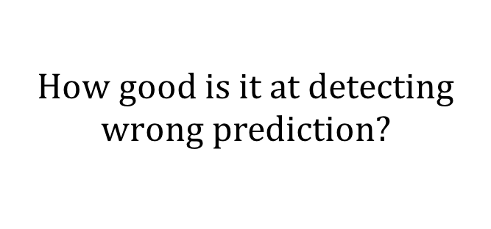



Recap
One wants a confidence estimator $\hat{c}\left(x\right)$ which performs well in:
$$Calibration$$
$$Discrimination$$
$$Informativeness$$
$$1$$
$$1$$
$$p\left(c\right)$$
$$Risk(τ)$$
$$I\left(\hat{c}\left(X\right) ;v\left(X\right)\right)$$
$$0$$
$$0$$
$$c$$
$$1$$
$$0$$
$$Coverage(τ)$$
$$1$$
$$How good is it at$$
$$informing us on the$$
$$validity of prediction?$$
$$How interpretable is it as$$
$a Probability$?
$$How good is it at detecting$$
$$wrong prediction?$$
$$CURRENT$$
$$NEW$$

Slide 20
What are people using ?

Slide 21
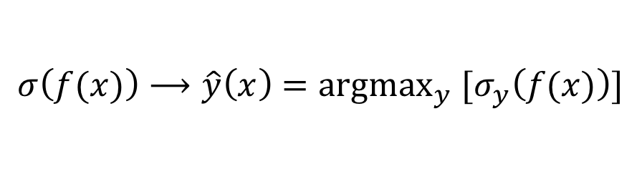
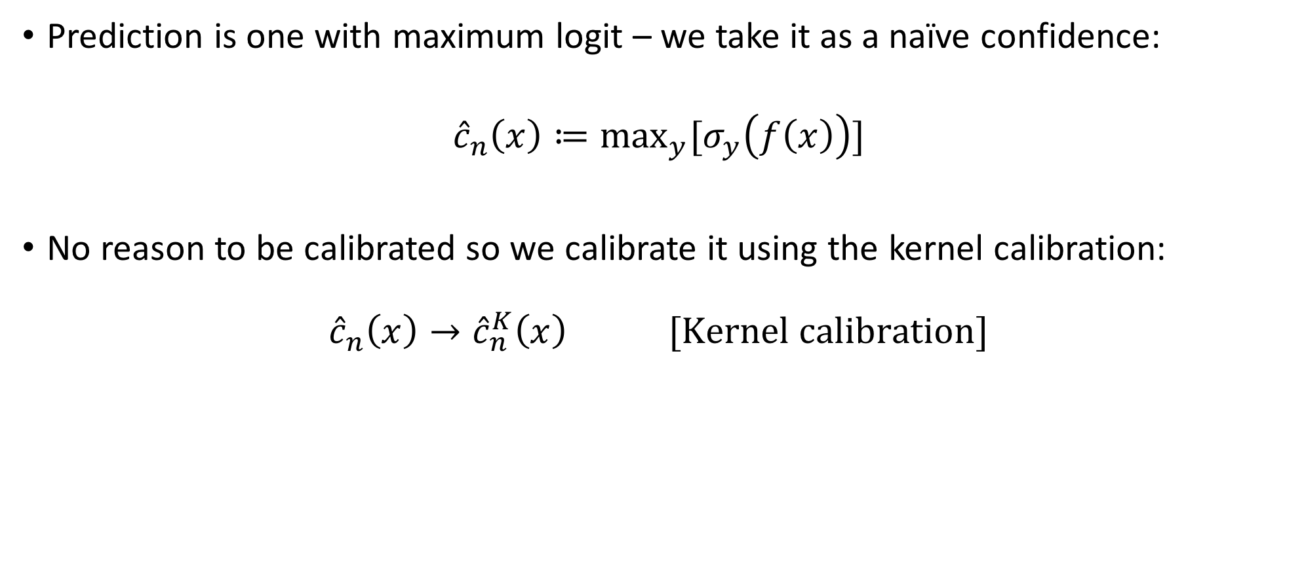
Maximum logits as a confidence estimator
$$σ\left(f(x)\right)⟶\hat{y}\left(x\right)={argmax}_{y} [σ_{y}\left(f(x)\right)]$$
Prediction is one with maximum logit – we take it as a naïve confidence:
$${\hat{c}}_{n}\left(x\right)≔\max_{y}{[σ_{y}\left(f\left(x\right)\right)]}$$
No reason to be calibrated so we calibrate it using the kernel calibration:
$${\hat{c}}_{n}\left(x\right)→{\hat{c}}_{n}^{K}\left(x\right) [Kernel calibration]$$

Slide 22
What are people using ?
The (kernel) calibrated maximum logit value.

Slide 23
How can we do better?

Slide 24
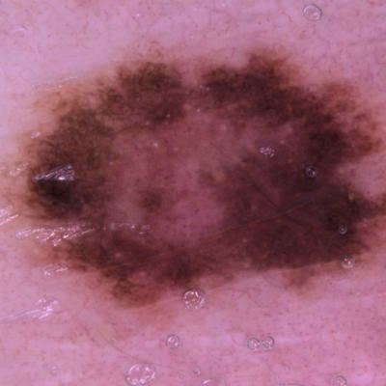
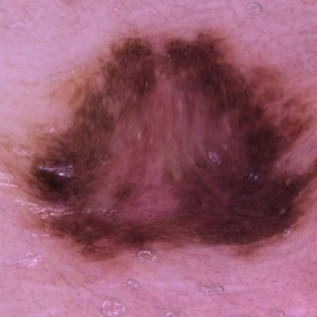
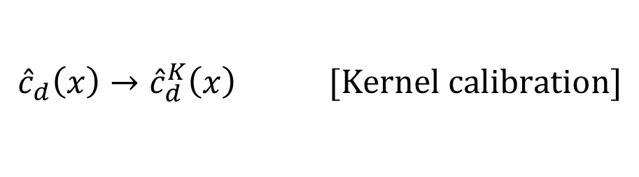

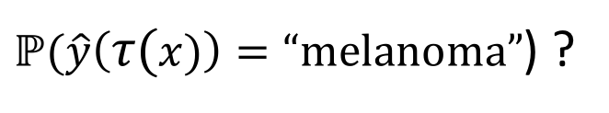

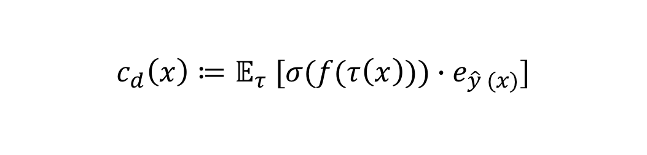
Smooth transformations to leverage new information
Leveraging a new source of (local) information by deforming input with smooth transformations and seeing how the network consistently predicts the transformed output:
A proxy is to take the average logit of the transformed inputs along the prediction:
Which is then calibrated using the kernel calibration :
$$Transformation, τ$$
$$\hat{y}\left(x\right)=“melanoma”$$
$ℙ(\hat{y}\left(τ(x)\right)=“melanoma”$) ?
$$c_{d}\left(x\right)≔𝔼_{τ} [σ(f(τ\left(x\right)))∙e_{\hat{y} (x)}]$$
$${\hat{c}}_{d}\left(x\right)→{\hat{c}}_{d}^{K}\left(x\right) [Kernel calibration]$$

Slide 25
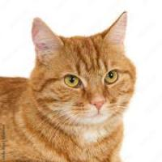
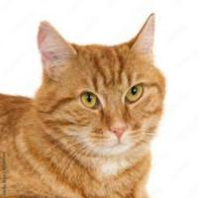


Diffeomorphisms as choice of transformations
We use diffeomorphisms as a choice of smooth transformation:
$$Norm$$
$$Network performance is linked to its stability to diffeomorphisms$$
[1]
$$Can confidence be linked to local stability to diffeomorphisms?$$
[1] L. Petrini et. Al, 2021

Slide 26
How can we do better?
We introduce a confidence that leverages stability to diffeomorphisms as an indicator of confidence which we kernel calibrate.

Slide 27



Data used
HAM-10000:
Real medical images
7 classes (benign vs different types of lesions)
CIFAR-10
Benchmark dataset
10 classes

Slide 28
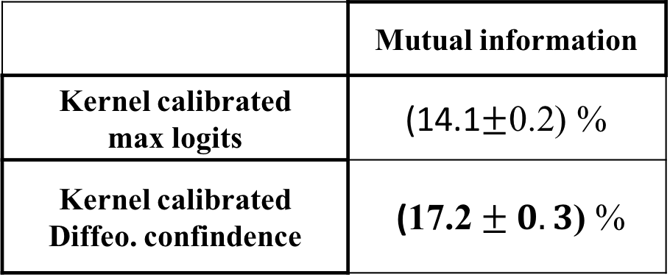

Results for HAM-10000
$$I\left(\hat{c}\left(X\right) ;v\left(X\right)\right)$$
 | Mutual information
Kernel calibrated max logits | (14.1$±\text{0.}\text{2}$) %
Kernel calibrated Diffeo. confindence | ($\text{17}\text{.}\text{2}±0.3$) %
Performance of the two confidences on HAM-10000 with a Standard CNN

Slide 29



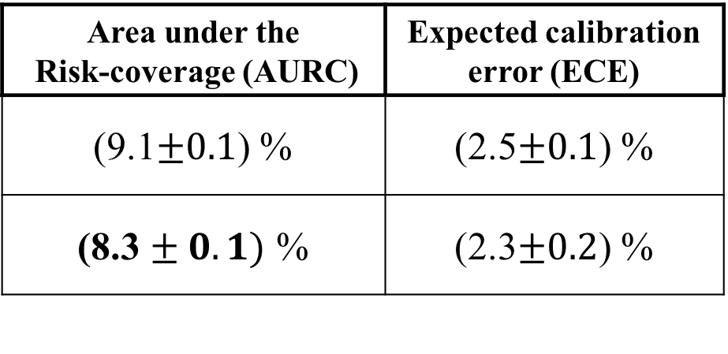






Results for HAM-10000
$$1$$
$$1$$
$$Risk(τ)$$
$$p_{\hat{c}}\left(c\right)$$
$$I\left(\hat{c}\left(X\right) ;v\left(X\right)\right)$$
$$0$$
$$0$$
$$Coverage(τ)$$
$$1$$
$$0$$
$$c$$
$$1$$
 | Mutual information
Kernel calibrated max logits | (14.1$±\text{0.}\text{2}$) %
Kernel calibrated Diffeo. confindence | ($\text{17}\text{.}\text{2}±0.3$) %
Area under the Risk-coverage (AURC) | Expected calibration error (ECE)
(9.1$±0.1$) % | (2.5$±0.1$) %
(8.3 $± 0.1)$ % | (2.3$±0.2$) %
Performance of the two confidences on HAM-10000 with a Standard CNN

Slide 30
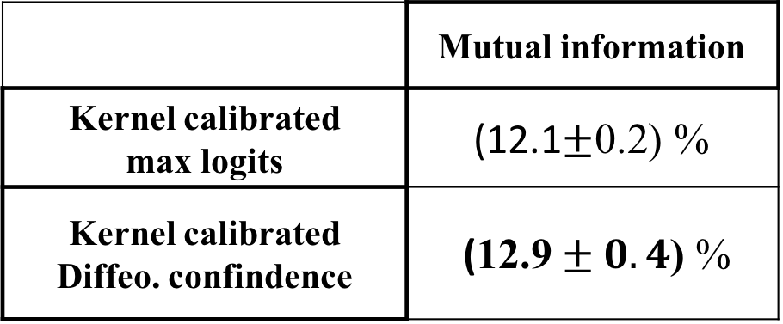
Also true for CIFAR-10
$$I\left(\hat{c}\left(X\right) ;v\left(X\right)\right)$$
 | Mutual information
Kernel calibrated max logits | (12.1$±\text{0.}\text{2}$) %
Kernel calibrated Diffeo. confindence | ($\text{12}\text{.}\text{9}±0.4$) %
Performance of the two confidences on CIFAR-10 for VGG-11 (similar for Resnet-18)

Slide 31
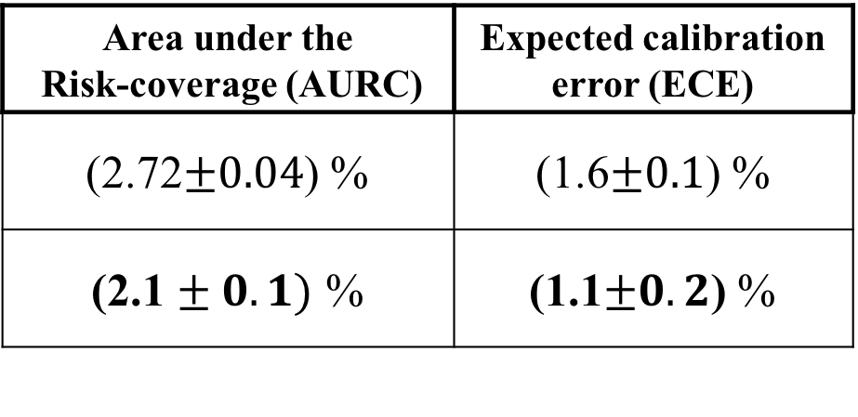
Also true for CIFAR-10
$$1$$
$$1$$
$$Risk(τ)$$
$$p_{\hat{c}}\left(c\right)$$
$$I\left(\hat{c}\left(X\right) ;v\left(X\right)\right)$$
$$0$$
$$0$$
$$Coverage(τ)$$
$$1$$
$$0$$
$$c$$
$$1$$
 | Mutual information
Kernel calibrated max logits | (12.1$±\text{0.}\text{2}$) %
Kernel calibrated Diffeo. confindence | ($\text{12}\text{.}\text{9}±0.4$) %
Area under the Risk-coverage (AURC) | Expected calibration error (ECE)
(2.72$±0.04$) % | (1.6$±0.1$) %
(2.1 $± 0.1)$ % | (1.1$±0.2$) %
Performance of the two confidences on HAM-10000 with a Standard CNN

Slide 32
Conclusion
Introduce mutual information as a measure to evaluate confidence estimators
Show that diffeomorphism successfully extract more information than simply looking at the maximum logit (and also improve in the original frame work)
For practical data (HAM-10000) & benchmark dataset (CIFAR-10) and various architectures

